Slide 1
MOCK TRIAL DAY 4

Slide 2
GET INTO YOUR TEAMS
WE WILL WATCH A SHORT CLOSING ARGUMENT SPEECH IN A LAW AND ORDER EPISODE
https://www.youtube.com/watch?v=uvackRgeDwg
What makes his speech persuasive?
How does he address the audience’s emotions?
How does he appeal to their logic?

Slide 3
Trial Procedures
1) Prosecution Team: 5-10 minute speech
2) Juror Team: 2 minutes to ask questions
3) Socrates Defense Team: 5-10 minute speech
4) Juror Team: 2 Minutes to ask questions
5) Juror Team: Deliberation for 2 Minutes
6) Juror Team: Announce Decision

Slide 4
Final Paper 2-3 Pages (typed)
See rubric in Dossier
Justices Teams:
Write an Official Opinion of a the case
1) Give your decision
2) Explain your decision
Notes:
Describe an what an Official Supreme Court Opinion is.

Slide 5
Final Paper 2-3 Pages (typed)
See rubric in Dossier
DEFENSE, PROSECUTION and JUSTICES TEAMS
Final Paper Assignment
For you final paper assignment you will justify your final verdict (justices) or argument (Prosecution and Defense) in an opinion paper. You will have to recognize both arguments but ultimately explain why your side has the superior argument. The paper should be 2-3 pages in length. Below is the rubric.

Slide 6
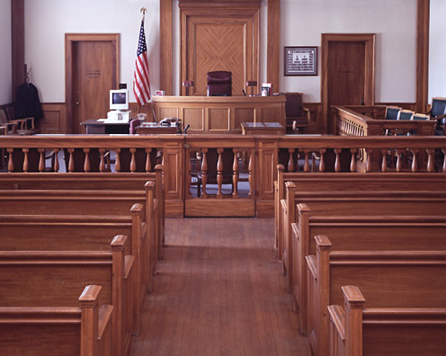
Questions for audience….
What was the most convincing argument of the defense?
What was the most convincing argument of the prosecution?
What was the most challenging question posed by the Justices?

Slide 7
The Execution of Socrates
Death by hemlock poisoning
Socrates was expected to flee Athens, but refused on principle
His reasons:
Age: He was already old and did not want to become frail, especially away from his home and family
Martyrdom: He was aware of the symbolic importance of his actions

Slide 8
The Legacy of Socrates
Socrates became a symbol of Western Philosophy
Students of philosophy should ask questions in order to understand the world
Socrates asked many questions about life, knowledge, and morality
Philosophers in Western history have tried to answer these questions and ask more questions of their own

Slide 9
The Role of the Philosopher
He can either support or challenge current society
What kind of philosopher was Socrates?
Next Unit: Rome
Cicero: A philosopher that supported the Roman Republic

