Slide 1
The Purpose of Questioning
Exploring Inquiry through Ancient Greece

Slide 2
Warm-Up
Why do we ask questions?
List specific reasons or purposes for asking a question
You can also list specific examples (both in school and at home)
Notes:
Discussion:
-First I will let students give answers and write them on the white board
-We will then categorize types of question. I anticipate that I will have to prompt students a lot in this discussion. There will most likely be a lot of the first two categories but not the last two.
To gather information or clarify information
To direct future research
To challenge
To form an argument or understanding

Slide 3
Purposes for Questioning
To gather information or clarify information
To direct future research
To challenge
To form an argument or understanding
Notes:
For the next three days we will focus on the on the first two purposes. You will refine your ability to specifically ask questions for the purpose of directing further research and fueling your own curiosity.
The rest of the unit we will explore the last two purposes, because they will take more time to refine and develop.

Slide 4
“It is a miracle that curiosity survives formal education.”
ALBERT EINSTIEN
“The power to question is the basis of all human progress.”
Indira Ghandi
Notes:
So why I am I focusing on questions? I think Albert Einstein's joke here sums it up pretty well.
Can anyone explain it?
Can anyone define Curiosity?
I have been guilty and probably many of your teachers have been guilty and one point in time of squashing curiosity. I love history so much that I just want to tell you all about it. Talk and Talk and Talk but not always listen to what you would like to know. In school you are often given the answers to questions but we never teach you how to ask questions. Questions fuel curiosity and curiosity fuels humanity.
Can someone explain the second quote?
-Curiousity and Questioning fuel the progress of society. Can anyone think of examples of in history when this is the case?

Slide 5
ANCIENT GREECE
ATHENS AND SPARTA
Notes:
Today We are going to have a short lecture on Ancient Greece and Ancient Athens. I have given you all three post-it notes. During the lecture if there is something that interests you or sparks a question write it down (you can also ask me questions like normal). At the end of the lesson, I will give you time to finish writing questions. You do not have to put your name on a post-it note
Lecture adapted from multiple sources including my own lecture notes from Ancient Greek history, Aruna Arjunan’s 9th Grade World History Lecture, and ‘the glory that was greece’ lecture from frankford college

Slide 6
Geography
To the left is a map of Greece. The highlighted portion is Greece. The brown shades indicate higher elevation. What stands out about the geography of Greece?

Slide 7
Greek Geography
Most of the land is very mountainous
Defined the way of life – instead of one unified state, lots of little city-states, each with their own governance
Independent communities
Also makes transportation really difficult
Greeks did not live on the land, but around the sea
Aegean Sea, Ionian Sea, and Black Sea all linked different parts of Greece
Spectacular sailors
Sea travel and trade equally important because Greece lacked a lot of natural resources

Slide 8
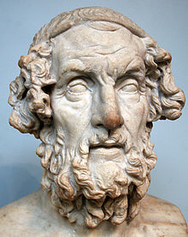
The Age of Homer
Circa 1000 B.C.E.-circa 750 B.C.E.
Greece’s “Dark Ages” – little information known
The Illiad- Epic Poem about the Trojan War
The Oddyssey- Epic Poem about one many
Sacred books in later Greek culture
Notes:
Homer- Not a real person, a collection of people

Slide 9
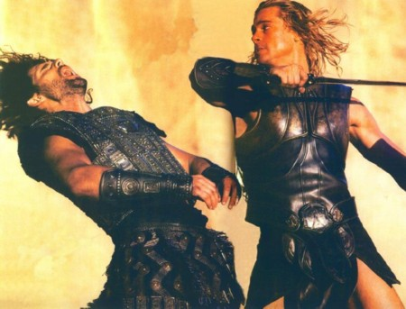
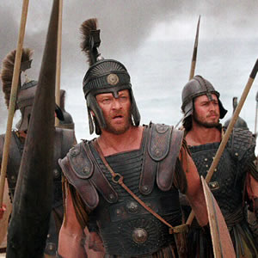
The Iliad and the Odyssey
-Defined Manhood
-Humans relationship with the gods
-How to conduct yourself in war
Notes:
For those of you who are familiar with a religion. How does the bible direct its citizens to act? The Koran? Etc.

Slide 10
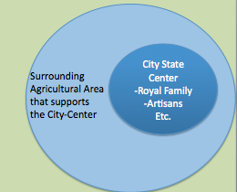
Greek City-States
By 750 BC: the city-state or polis was the fundamental political unit
City-states controlled about 50 – 500 square miles of territory
Usually fewer than 10,000 residents
Athens and Sparta

Slide 11
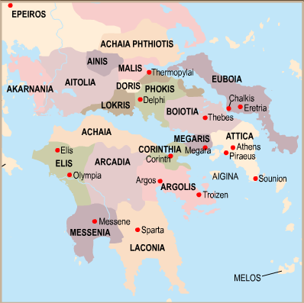
Notes:
This is a Map of the Greek Peninsula. Does anyone recognize these? I know that many of you have studied them in your English class with mythology.

Slide 12
Forces uniting the Greeks

Slide 13
Forces Uniting the Greeks

Slide 14
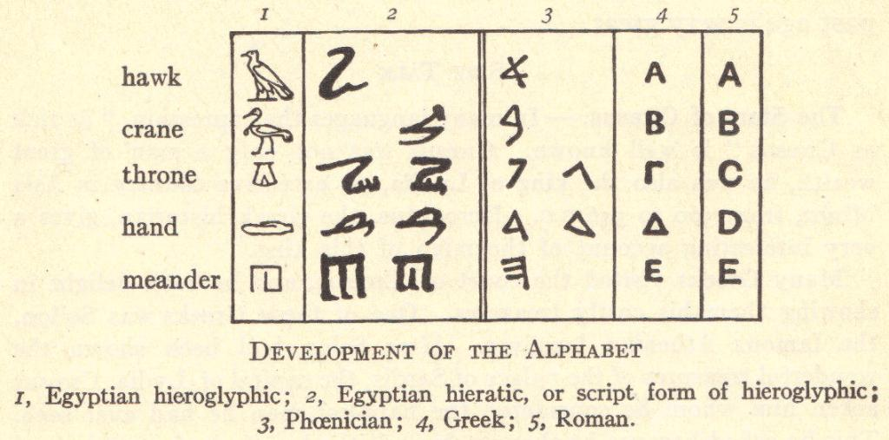
Greek Language and Alphabet

Slide 15
Forces Uniting then Greeks

Slide 16
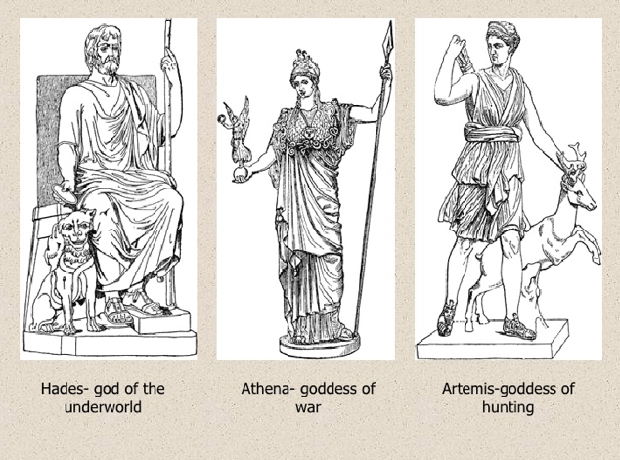
Greek Mythology
Notes:
For those of you who have studied greek mythology in English: what are some other gods/Goddesses?

Slide 17
Forces Disuniting the Greeks

Slide 18
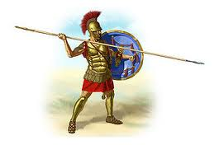
The Greek Warrior
The hoplite warrior
Through intense warfare with between the city-states, they perfected warfare and became the most effective military force in the Mediterranean
Carried the hoplon and the doru

Slide 19
Different Forms of Government
Monarchy | Aristocracy | Oligarchy | Direct Democracy
King Some rulers claim divine right Rule is hereditary | Ruled by nobility Rule is based on hereditary, social rank, wealth | State ruled by a small group of citizens Based on wealth and ability Ruling group controls military | State ruled by citizens Citizenship = basis for rule Majority rules in decisions

