Slide 1
Middle Passages Images
Image | Inferences about the Middle Passage
Notes:
Create this Table in your notebooks. I would like you to number each picture. I want you to write decent notes and observations. These notes will help you with your project

Slide 2
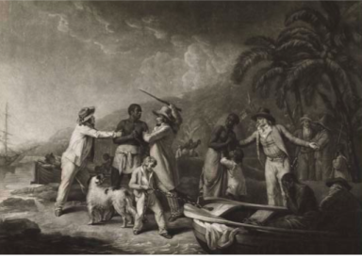

Slide 3
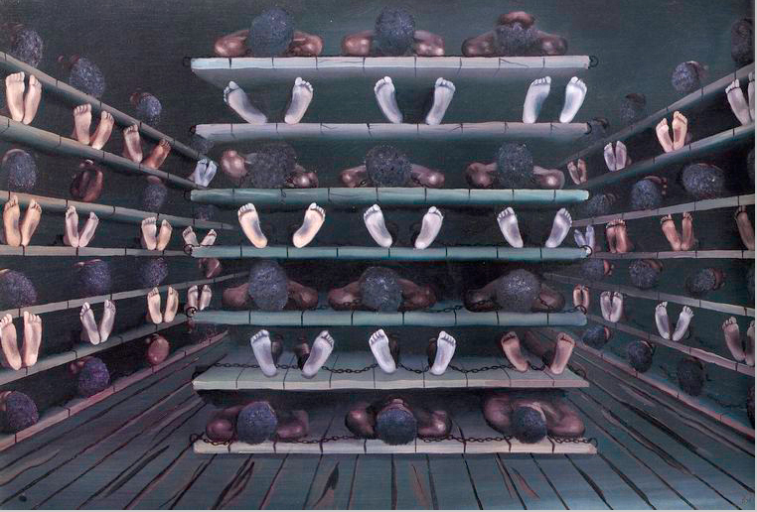
Notes:
Living quarters on a ship

Slide 4
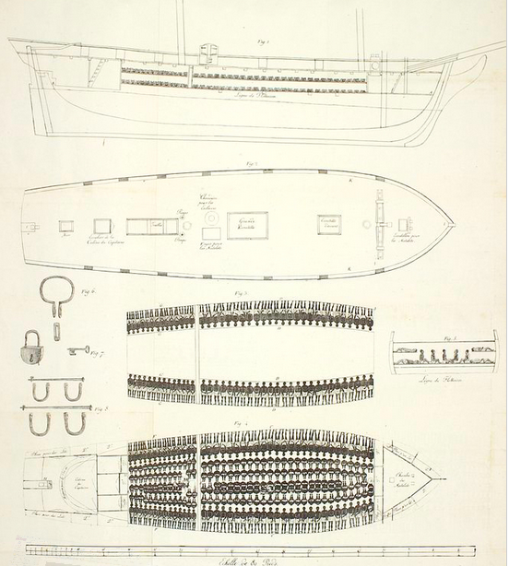

Slide 5
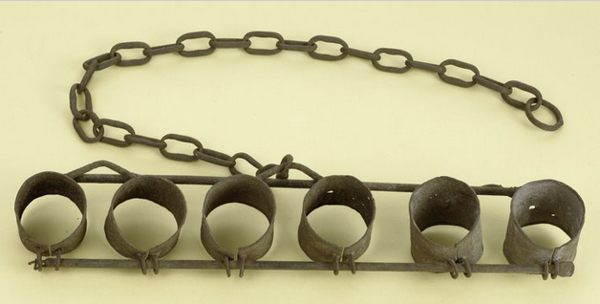
Notes:
This is often all that slaves wore. If they were often left naked, what does that tell you about how the slave traders viewed them?

Slide 6
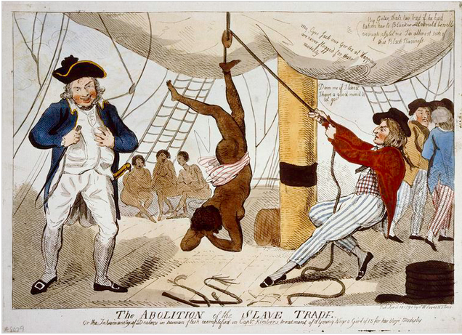
Notes:
Also accounts of sexual abuse

Slide 7
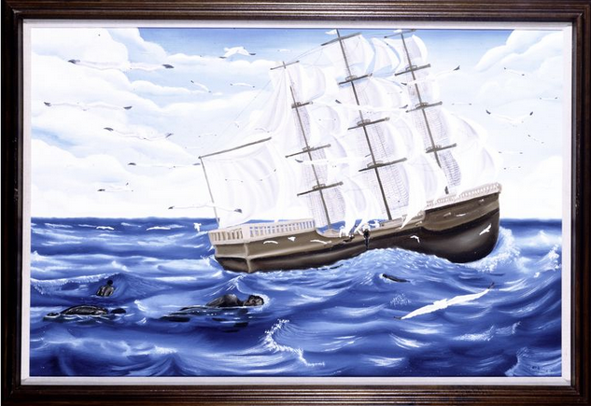

Slide 8
Branding Iron

Slide 9
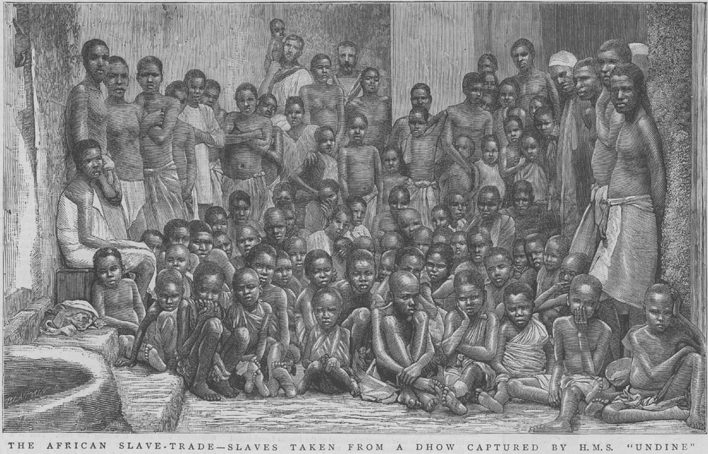
Slaves Rescued from a British Ship

Slide 10
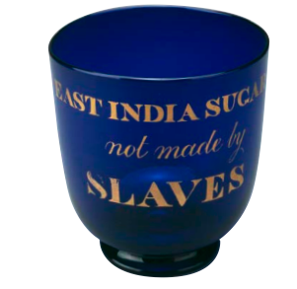

Slide 11
Letter of Protest
Read Olaudah Equiano’s account of the Middle Passage
Letter of Protest (2 Pages)
Write a letter to the King of Portugal or Spai nand ask these rulers to abolish the Atlantic slave trade, citing specific reasons and describing the horrors of such a voyage.
Consider who you will be in the letter (former slave trader, former slave, just an observer)
Use Specific Sources that we used in class. Either quote or describe
-Falconbridge’s Account
-Middle Passage Images
-Equiano’s Account
Notes:
Consider
-Your audience
-Your role
-what evidence will be persuasive
I realize that if were were really writing a letter at the time you would not cite the names of sources in parenthesis. But this is so you can start to get into the habit of citing for your other projects in this class

Slide 12
Proper Citation
CITE!!! After you put in a fact or a quote, add a citation in Parenthesis.
Quote: When you directly lift someone else’s words and put them in your own paper
Example) “ Slave traders access humans like they are horses” (Falconbridge)
Paraphrase: When rewrite someone else’s ideas in your own words
Example) The slaves were analyzed by the slave traders, just like horses (Falconbridge)

