Slide 1
WARM-UP
Why do we use the Socratic method?
Does the Socratic method challenge or support authority? Why?

Slide 2
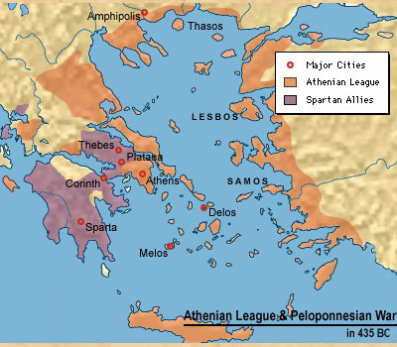
The Peloponnesian War 431- 404 BC
Athens and Sparta fought for control of the Greek peninsula and surrounding colonies
Sparta laid siege to the city of Athens
Athenians suffered from starvation and Siege
Surrendered to Sparta

Slide 3
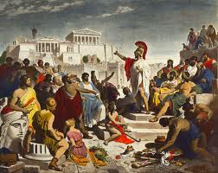
Athens in Crisis
Sparta set up the rule of the 30 tyrants in Sparta
Critias, a particularly brutal tyrant, was once a student of Socrates
Democracy Restored a year later
But every fragile
Athens would never truly recover

Slide 4
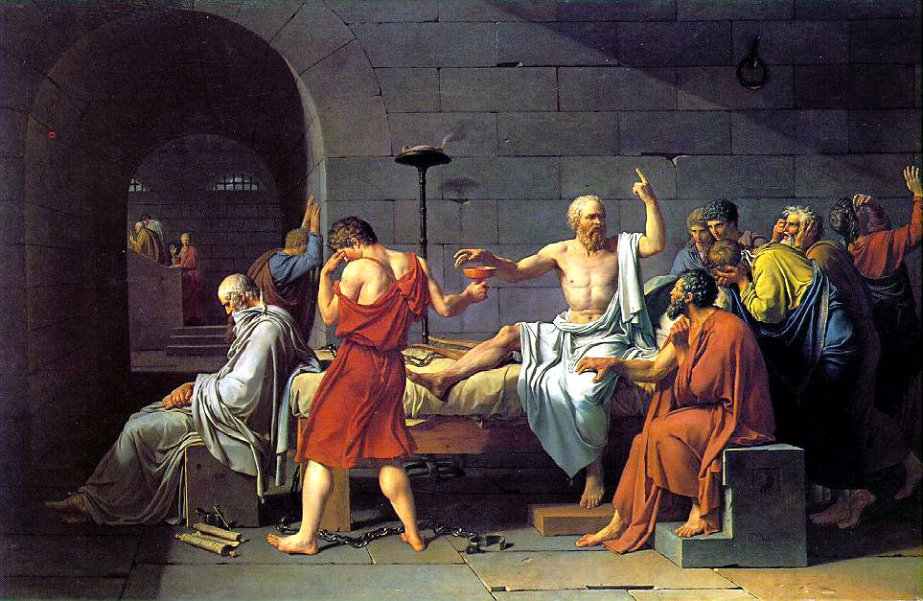
The Trial of Socrates
Athens convicted Socrates of impiety and corrupting the youth
Condemned to die by drinking poison (hemlock)

Slide 5
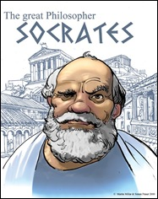
The Mock Trial of Socrates
How can questions help us form our arguments?

Slide 6
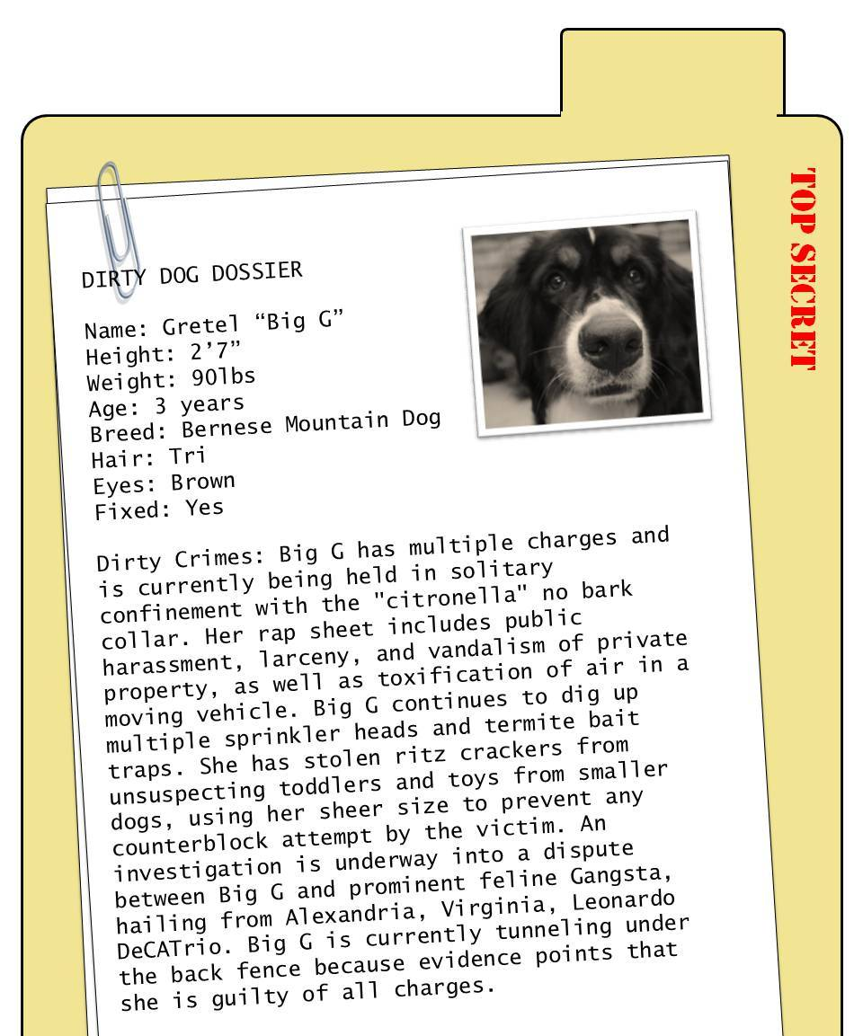
Your Case Dossier
You will hand back this dossier with your completed work at the end of the trial
Dossier: a file with all your information on the case or person on trial
Socrates Rap Sheet
Two Readings
Each Days Worksheets
Grading Rubrics
Lets Review the Socrates’ Rap Sheet

Slide 7
Socrates v. Athens
Justices:
Anh, Lila, Moenay, Raj
Prosecution Lawyers:
Ava, Gina, Tiffanie, Natan, Ciara,
Socrates Lawyers:
William, Francesca, Taylor, Zayim, Beatriz
Justices:
Albert, Robert, Carter, Chris
Prosecution Lawyers:
Mei, Amanda, Kimberly, Tania, Alison,
Socrates Lawyers:
Danilee, Jennifer, Ahmed, Adel, Lucy

Slide 8
What questions do we need to ask?
In your group, brainstorm what you need to know to create an argument for the defense/prosecution
If you are the jurors, create questions for what you need to know to decide whether Socrates is guilty or innocent
Write your questions on the giant post-it note paper
Be prepared to present your questions to the class

Slide 9
FIRST PIECE OF EVIDENCE
READ THE SUMMARY OF THE APOLOGY
You will be graded on thoughtful highlighting and note taking
What is useful highlighting?
Don’t highlight the whole page, then its useless. Highlight key points in a paragraph
What is useful note taking?
Questions?
Key arguments
Note taking is really useful if you want to go back to a long reading and find a specific passage or argument

