Slide 1
Ancient Greece Day 3
ATHENS AND SPARTA

Slide 2
Warm-up
NO WARM-UP TODAY!
FORM YOUR GROUPS AND SEND SOMEONE TO GET LAPTOPS
FINALIZE YOUR PRESENTATION
YOU WILL HAVE 15 MINUTES

Slide 3
Presentation Line-Up (3 minutes each) *Student Presentations are just as Important as a lecture
GROUP 1
GROUP 2
GROUP 3
GROUP 4
GROUP 5

Slide 4
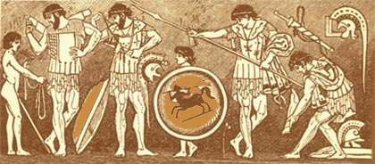
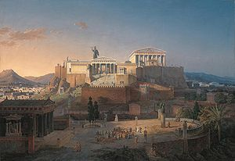
ATHENS and SPARTA
Versus
Notes:
I know many of you already have some idea of these two places before this class. Which picture do you think goes with which city state?
Just looking at these pictures: What do you think the Spartans valued compared to the Athenians?

Slide 5
CITY-STATE POPULATION
Athens | Sparta
Approx. 140,000 people: 40,000 citizens 40,000 slaves Rest were foreigners Strong navy | Approx. 8,000 men citizens 100,000 slaved and semi-enslaved Strong army – best and feared fighters

Slide 6
GOVERNMENT STRUCTURE
Athens | Sparta
Main body of government: Assembly / Direct democracy Open to all citizens Passed laws and made policy decisions Everyone attended assembly Council of 500 that enforced decisions Women not involved in gov’t | Classified as an Oligarchy Two kings who were in general command of the armies with some religious duties Five overseers elected annually ran day to day operations Assembly of all males over the age of 30 who could support or veto council’s recommendations Women were not involved in gov’t
Notes:
How are both of these the same?
How are they different?
How do they compare to Egyptian Government?

Slide 7
SOCIAL STRUCTURE
Athens | Sparta
Social Structure: Aristocrats with large estates on top Middle ranks = small farmers Lowest class = thetes (urban craftsmen), metics (came from outside of the city), slaves (no rights, an owner could kill their slave) | Social Structure: Spartiates (military professionals who lived in barracks, served in the army & could vote) Perioeci (freemen, including artisans, craftspeople, couldn’t vote or serve in army) Helots (serfs – treated like slaves)

Slide 8
LIFE STYLE AND VALUES
Athens | Sparta
Life style and values: Participation in government / Civic duty Cultural superiority in Athens Valued art, architecture, drama, literature, philosophy, and science | Life style and values: Militaristic values Children and citizens were raised to be “Spartan” Not permitted to own luxury goods “Return victorious or die fighting”

Slide 9
THE ROLE OF WOMEN
Athens | Sparta
Women were kept at home, no participation in sports or politics Wives were considered property of their husbands Responsible for domestic arts Some women held high posts in rituals or religious ceremonies | Girls were educated in reading and writing Girls could participate in sports Goal was for women to produce strong, healthy babies Given a lot of freedom to move around, could own their own property
Notes:
Given all that you know about Athens and Sparta where would you rather live? By a show of hands
Brief discussion about choices

