Slide 1
Slave Trade The Middle Passage

Slide 2
What are the disadvantages of looking at history through an economic lens? What do we focus on? Who do we forget?
Warm-Up

Slide 3
To Understand an Event in history we must look at that event through multiple lenses including Economic, Cultural, Political and Critical.
Enduring Understanding

Slide 4
The middle passage demonstrates how humans justify inhumane and Questionable practices for economic reasons. Does this happen today?
History helping us understand today’s world
Notes:
Forever 21? Apple Computers? (no where close to slavery, but are these unethical practices?

Slide 5
The Middle Passage
A stage of the the Tran-Atlantic (triangular) trade. The journey of African slaves from Africa to the new world (both the US and Latin America)

Slide 6
FalconBridge’s Account
How do the Europeans evaluate the slaves?
Describe how the Europeans transport slaves
One part of the account that is disturbing to you
Notes:
Falconbridge was homework from the night before. We will review the answers as a class.
-F has a much larger account, but I only showed you the beginning. I wanted you to read about the beginning of the middle passage. It was also a very disturbing account of the horrors
-I asked you the disturbing question, because it is ok that you may have an emotional reaction towards history. We study the struggles of humans

Slide 7
The Middle Passage
By 1810,
10 Million Africans put onto slave ships
2 Million enslaved Africans died on the Middle Passage
Middle Passage: The voyage that brought enslaved Africans to the West Indies and later to the colonies of North America.
Notes:
If we just looked at the economics of slavery, we could never understand or truly appreciate the lives of those enslaved. Today we are going to attempt to understand the lives of these people through images and primary source accounts.

Slide 8
Middle Passages Images
Image | Inferences about the Middle Passage
Notes:
Create this Table in your notebooks. I would like you to number each picture. I want you to write decent notes and observations. These notes will help you with your project

Slide 9
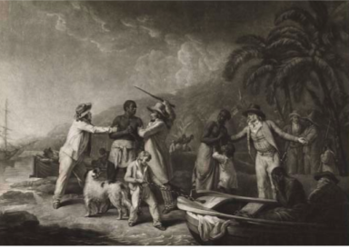

Slide 10
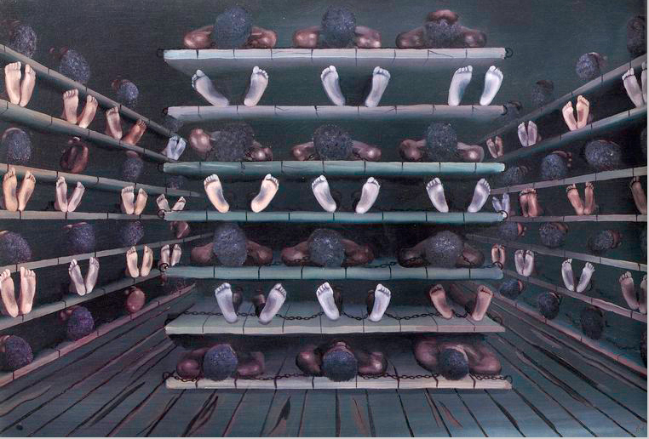
Notes:
Living quarters on a ship

Slide 11
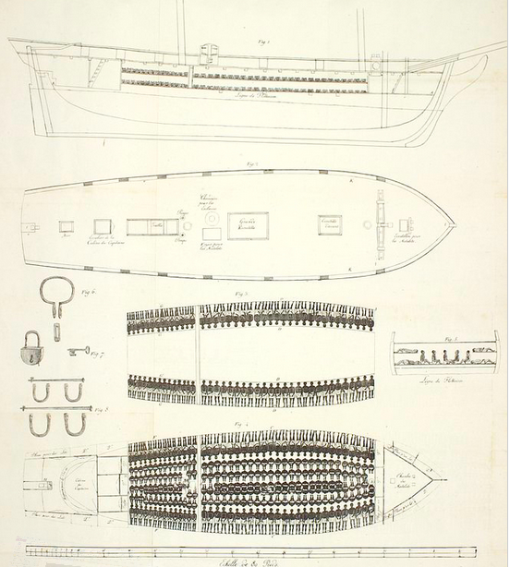

Slide 12
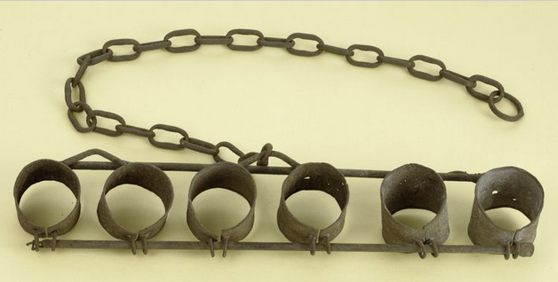
Notes:
This is often all that slaves wore. If they were often left naked, what does that tell you about how the slave traders viewed them?

Slide 13
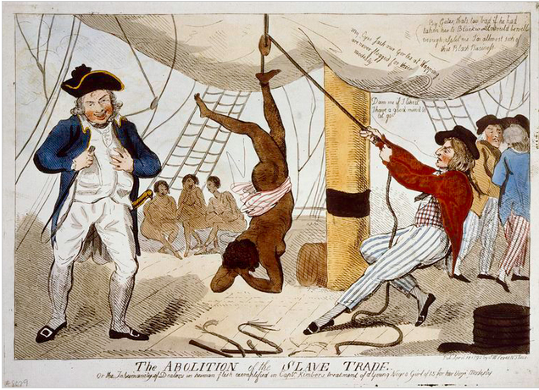
Notes:
Also accounts of sexual abuse

Slide 14
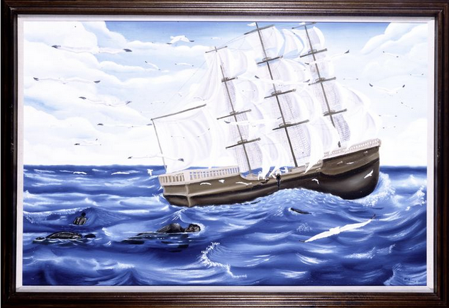

Slide 15
Branding Iron

Slide 16
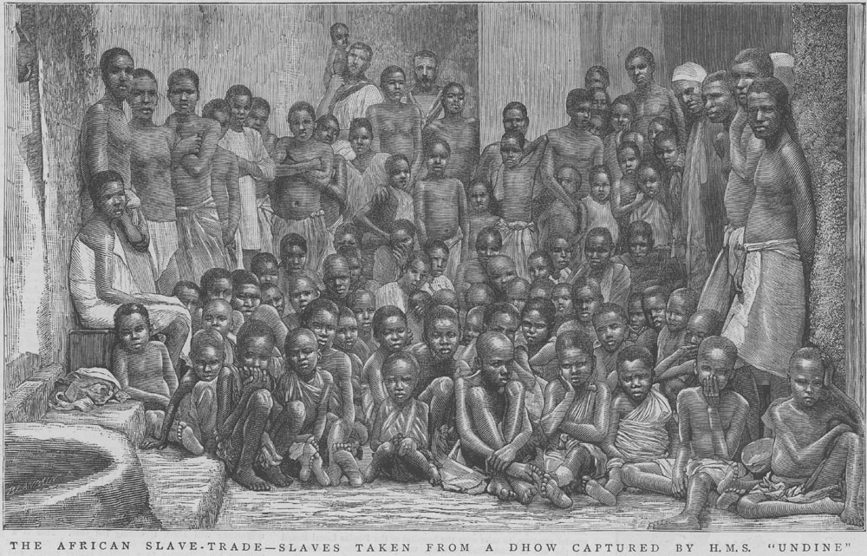
Slaves Rescued from a British Ship

Slide 17
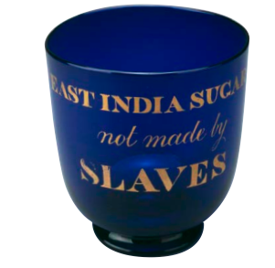

Slide 18
Letter of Protest
Read Olaudah Equiano’s account of the Middle Passage
Letter of Protest (2 Pages)
Write a letter to the King of Portugal or Spai nand ask these rulers to abolish the Atlantic slave trade, citing specific reasons and describing the horrors of such a voyage.
Consider who you will be in the letter (former slave trader, former slave, just an observer)
Use Specific Sources that we used in class. Either quote or describe
-Falconbridge’s Account
-Middle Passage Images
-Equiano’s Account
Notes:
Consider
-Your audience
-Your role
-what evidence will be persuasive
I realize that if were were really writing a letter at the time you would not cite the names of sources in parenthesis. But this is so you can start to get into the habit of citing for your other projects in this class

Slide 19
Proper Citation
CITE!!! After you put in a fact or a quote, add a citation in Parenthesis.
Quote: When you directly lift someone else’s words and put them in your own paper
Example) “ Slave traders access humans like they are horses” (Falconbridge)
Paraphrase: When rewrite someone else’s ideas in your own words
Example) The slaves were analyzed by the slave traders, just like horses (Falconbridge)

