Slide 1
Socrates and the Socratic Method
How can we use questions to challenge a belief or argument?

Slide 2
Warm-up
Do you ever challenge your parent’s rules?
Can you think of an example?
Have you ever challenged a teacher’s rule or assignments? How?

Slide 3
Enduring Understandings Essential Questions
How can we use questions to challenge a belief or argument?
When we form a challenge against a belief or rule questions can help direct and organize our argument
We can use questions to strengthen an argument or belief.
Socrates development of the elenchus (Socratic method) is one effective method of questioning that continues to be used in the Western World

Slide 4
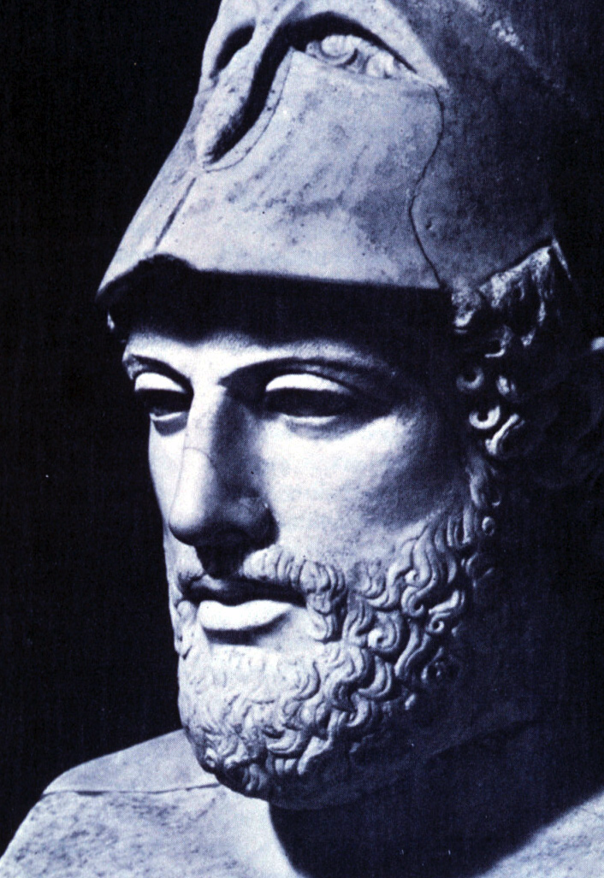
ATHEN’S GOLDEN AGE
In between the Persians Wars and Peloponnesian War
Pericles (right) was a famous general that had a lot of influence in the democratic government
Construction of the Parthenon
Art, Philosophy, Literature and Theatre all flourished

Slide 5
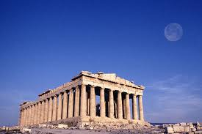
THE PARTHENON

Slide 6
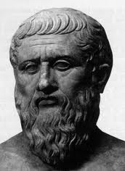
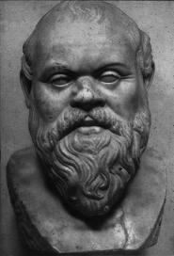
SOCRATES AND PLATO
Socrates
“The Father of Philosophy”
Prominent Citizen
Began to question the values and beliefs of Democratic Athens
“the gadfly”
Plato
Student of Socrates
Wrote Socrates’ conversations down
Started a school of philosophy
Attempted to answer many of Socrates questions about the meaning of life etc.

Slide 7
The Socratic Method or Elenchus
Individual Athenian has a belief or argument
Socrates would constantly question the belief to challenge it
“THE ONLY TRUE WISDOM IS KNOWING THAT YOU KNOW NOTHING”- Socrates

Slide 8
Some of Socrates’ Question
Is our government good?
Are the gods real? If they are real where do they live?
Can we define Beauty?
How has the right to rule Athens?
What is goodness?

Slide 9
A VIDEO EXAMPLE OF A SOCRATIC DIALOGUE
What is the Socratic Problem?
What is Socrates contribution to philosophy?
What is the question in the dialogue?

Slide 10
SOCRATIC DIALOGUE GROUPS
Adel, Raj,
Francesca, Ava
Tania, Tiffanie
Lucy, Albert
Ciara, Taylor
Amanda, Robert
Jennifer, Lila
Carter, Anh
William, Kimberly
Moenay, Danilee
Zayim, Mei
Alison, Ahmed
Natan, Gina
Beatriz, Chris

