Slide 1
THE PERSIAN WARS
USING QUESTIONS TO ANALYZE THE VALIDITY OF A NARRATIVE OR SOURCE

Slide 2
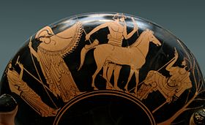
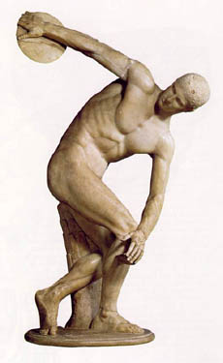
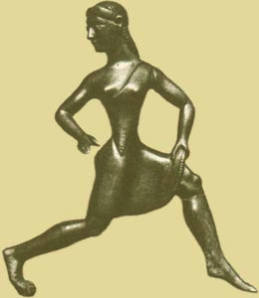
Analyze the art below. Which is from Athens Which is from Sparta? Explain

Slide 3
Presentation Line-Up (3 minutes each) *Student presentations are just as important as a lecture
GROUP 1
GROUP 2
GROUP 3
GROUP 4
GROUP 5
Fill out presentation table!
It will be collected!

Slide 4
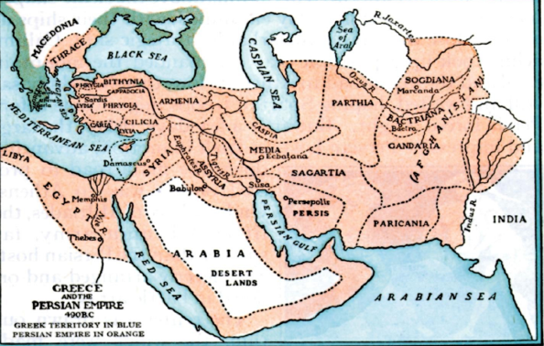
ANCIENT GREECE AND THE PERSIAN EMPIRE AT 490 BCE

Slide 5
The Persian Wars: BASIC TIMELINE
499 B.C.E
Greeks colonies in Asian Minor revolted against Persian rule
Athens sent troops to support the revolt. Persia crushed the it
499 B.C.E
Emperor Darius Sent troops to Greece to punish them
Athenians defeat them at the Battle of Marathon

Slide 6
The Persian Wars: BASIC TIMELINE
480 B.C.E
Persians Return to Greece under Emperor Xerxes
Battle of Thermopile: 300 Spartans hold back but are eventually defeated by the larger Persian army
480 B.C.E
Athens defeat the Persians at the Battle of Salamis
479 B.C.E
Athens and Sparta fight together and defeat Persians at the Battle of Plataea

Slide 7
The Traditional Historical Narrative: “Greece’s Greatest Hour”
DEFINED AS A BATTLE OF GOOD AGAINST EVIL
FREEDOM VS. SLAVERY
EAST VS. WEST

Slide 8
ENDURING UNDERSTANDING
THE PURPOSES OF QUESTION: EVALUATING A HISTORICAL NARRATIVE
We can use questions in history to evaluate the validity of a historical narrative.
Question the narrative (or story) of any historical book or film.
How do we question a historical narrative?

Slide 9
How do we critique a historical narrative?
Ask Questions!
What are their sources?
Do they portray one group as the heroes and one group as the villians? Why is this suspicious?

Slide 10
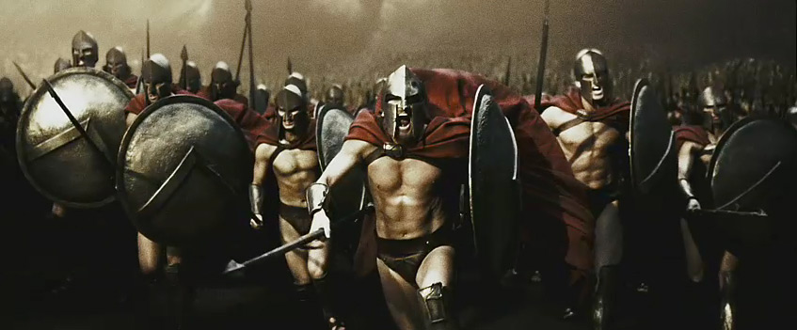
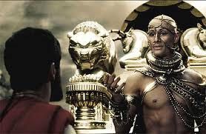
Traditional Narrative of the Persian Wars
View2 clips from 300. What questions should we ask?
Just not true (even though it was a cool movie)
Notes:
If we are to evaluate this historical narrative what questions should we try to answer while watching the clips.
Examples:
How are the Spartans portrayed?
How are the Persians portrayed?
Is there good vs. evil narrative?
What are their sources?

Slide 11
HOMEWORK: BE A MOVIE CRITIC
Read article on the Myths of the Persian War
Write a short movie review of the 300:
Role: Historian Movie Critic
Audience: Newspaper Readers
Format: 1 Paragraph Movie Review
Theme: The accuracy (or lack of accuracy) in the 300 film
Using your own knowledge of the Persian wars and the article above, critique 300’s traditional narrative. Write one paragraph reviewing the film clips.
Recommend Three Questions for Your Readers
Create three questions that your readers can use if they want to analyze the validity of a historical narrative in a film or book

