Slide 1
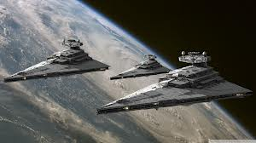
The Invasion of the Tiffs
Imperialism Simulation

Slide 2
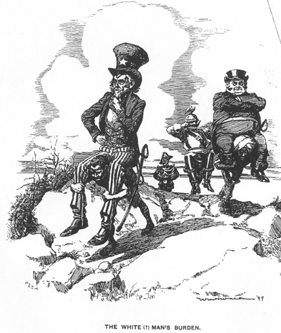
WARM-UP
What is the message of this political cartoon?
Does it agree or disagree with the White Man’s Burden?

Slide 3
Create a Graphic Organizer
Notes:
This graphic organizer will help you consider the

Slide 4
The Tiffs have Invaded Earth

Slide 5
Tiffs & Earthlings Simulation
Tiffs & Earthlings
Roles
Get into groups & prep for Council Meeting:
Tiffs: Great Tiffling will speak, tell Earthlings what your intentions are, can only make 2 changes immediately – one economic, and one social.
Earthlings: Mayor will speak, and present the town plan for dealing with the Tiffs

Slide 6
Tiff Group | Earthling Groups
Great Tifffling – Makes laws, administers justice Agricultural Rep – laws for getting farmers to switch from grains to zucchini Industrial Rep – how to change the factories into zucchini processing plants & shipping the zucchini back to TIFF Morality Rep – get earthlings to cover necks, start each sentence the way Tiffs do Cultural Rep – replace all Earth music and dance with Tiff music and dance | Mayor – in charge of city & city rep at town meetings (2 Mayors for groups of 6) Economic Rep – how will you maintain economy? Cultural Rep – what kinds of celebrations do you want to support / try to keep? What are some compromises you might make? Social Rep – what is important to you about your families? How will they deal with the transition to Tiff rule? Rights Rep – What kind of human rights and freedoms do you support in your town?

Slide 7
Town Characteristics
Town | Characteristics
Kneebone | -Largely Agricultural -Economy focuses on healthy Organic Vegetables -Climate similar to Southern California
Metropolis | -urban area, similar to Detroit -known for its music industry -once had many factories but some are abandoned now
Wheatville | -Agricultural area -focuses on wheat and corn -Socially conservative, often disagrees with Kneebone and Metropolis
Riotown | -Three main industries -tourism (beaches) -factories for major electronics and weapons -small farms on outskirts of city, growing a variety of produce

Slide 8
Groups
Tiffs | Metropolis | Kneebone | Riotown | Wheatville
Ava Chris Danilee Gina Carter | Mei Raj Francesca Beatriz Amanda | Ciara Taylor Natan Moenay Lucy Ahmed | Adel Zayim Lila Alison Albert Tiffanie | Anh William Kimberly Robert Tania Jennifer

Slide 9
Tiff Group | Earthling Groups
Great Tifffling – Makes laws, administers justice Agricultural Rep – laws for getting farmers to switch from grains to zucchini Industrial Rep – how to change the factories into zucchini processing plants & shipping the zucchini back to TIFF Morality Rep – get earthlings to cover necks, start each sentence the way Tiffs do Cultural Rep – replace all Earth music and dance with Tiff music and dance | Mayor – in charge of city & city rep at town meetings Earthling Relations Rep- How will you work with other earth towns in this transition. Do you have any suggestions for how other towns can organize considering their specialties? Economic Rep – how will you maintain economy? Cultural Rep – what kinds of celebrations do you want to support / try to keep? What are some compromises you might make? Social Rep – what is important to you about your families? How will they deal with the transition to Tiff rule? Rights Rep – What kind of human rights and freedoms do you support in your town?

Slide 10
EMAIL EXCHANGE
MAKE A PLAN to communicate outside of school

