Slide 1
Finish Your Group Work You Have Ten Minutes!

Slide 2
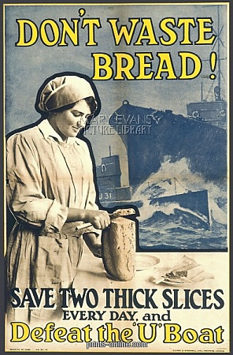
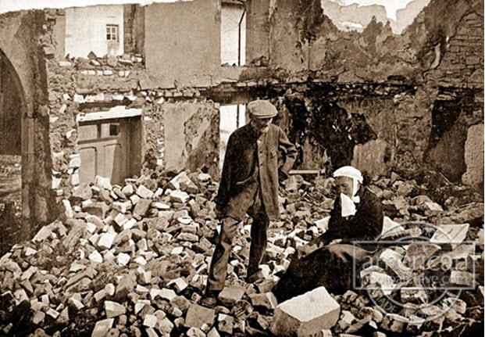
What are some ways in which civilians (non-soldiers) may have to sacrifice during a large scale war?

Slide 3
Total War
Military conflict in which the contenders mobilize all of their civilian and military resources in order to obtain a complete victory. It is distinguished from the partial commitment of lives and resources in limited war

Slide 4
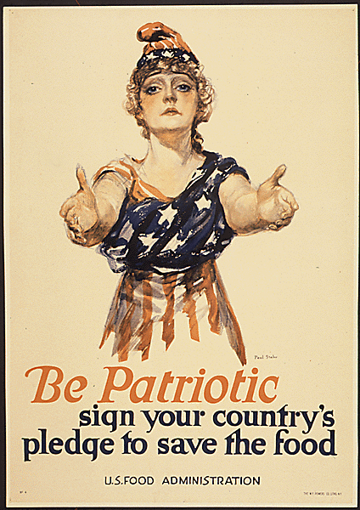
The Lives of Civilians During WW1

Slide 5
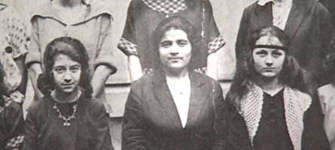
A Life of Her Own: the Transformation of a Countrywoman in Twentieth-Century France.
Memoir of a French Woman, Emilie Carles (1900-1976), Teacher
Lived in Remote mountain Village, Val-des-Prés
The war reached her small village

Slide 6
Read Excerpt of Memoir Concerning WW1
Teenager at the time
FYI
First Joseph- Sister’s Husband- Milk Man
Second Joseph- Older Brother
Explain how they found out about the war and their reactions.
List the ways in which WWI impacted Emilie Carles and her family

Slide 7
Group #1 Jennifer Mei Adel Taylor Carter
Group #2 Bobby Beatriz Alison Francesca Ahn
Group #3 Lucy Zayim Raj Will Gina
Group #4 Natan Tiffanie Danilee Ahmed Ava
Group #5 Tania Chris Lila Albert
Group #6 Ciara Moenay Kimberly Amanda

Slide 8
Group #1 Katherine Jessica Malcom Esther Ndi
Group #2 Demi Myia Lena Wiktor Khilah
Group #3 Estiwar Joshua Ciani Tia Justin
Group #4 Franklin David Benjamin Sam Allan
Group #5 Angeli Ryean Harmenjeet Ashin William
Group #6 Deborah Rubin Ying Jenet Karenjoy

Slide 9
Reading Groups
Pick a note-taker for the lesson (just write down bullet points/phrases)
Reading Debrief- about 10 minutes
Clarify any concerns about the text (What happened)
What was the most troubling event in the reading?
Did anything stand out to you or interest you?
How did this reading exemplify TOTAL WAR
How do all of the readings compare the start of the war to the reality of Total War? Give Examples from each text

Slide 10
The Lives of Nurses
MUSIC OF WORLD WAR ONE- THE ROSE OF NO MAN’S LAND
https://www.youtube.com/watch?v=sHFO2FSxg_8

Slide 11
Option 1: Found Poem/Rap- Experiences of WWI
Use all of your readings to identify phrases and words that are really poignant or important to you
Create a found poem by stringing those phrases and your phrases together. (does not necessarily need to rhyme)
Add two tableaus to your poem
-1 represents soldier life
-1 represents civilian life

Slide 12
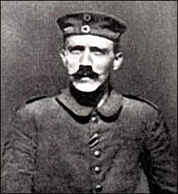
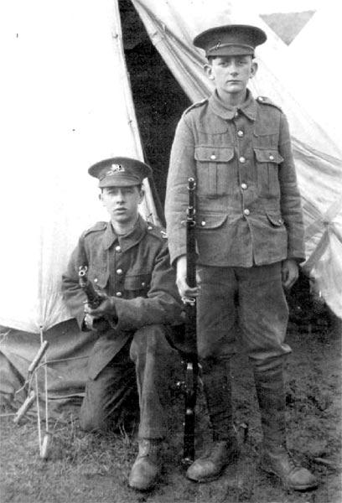
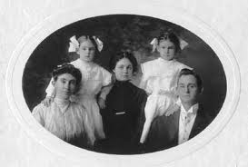
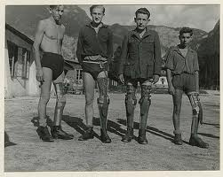
2-Part Writing Assignment
Letter From a Soldier
Due Next Monday
2 Page Letter
PICTURE (2 points extra credit)
Letter from a Civilian
Due Next Wednesday
1-2 page letter in response to a classmates letter from a soldier

Slide 13
Language: Would a soldier call the war World War 1? Why or why not?

